Slide 1
Reliable TCP Data Stream
Session 03
Course : COMP6584001 – Network and Systems Programming
Ivan Sebastian Edbert

Slide 2
Learning Objectives
At the end of this session, the student will be expected to :
Understand about TCP
Able to work with TCP
Able to establish TCP with GO

Slide 3
Outline
TCP Data Stream
Establish TCP Session
Establish TCP with Go Library

Slide 4
Transmission control protocol (TCP)

Slide 5
Transmission control protocol (TCP)
Definition
Transmission Control Protocol (TCP) is a communications standard that enables application programs and computing devices to exchange messages over a network. It is designed to send packets across the internet and ensure the successful delivery of data and messages over networks.
TCP is one of the basic standards that define the rules of the internet and is included within the standards defined by the Internet Engineering Task Force (IETF). It is one of the most commonly used protocols within digital network communications and ensures end-to-end data delivery.
TCP organizes data so that it can be transmitted between a server and a client. It guarantees the integrity of the data being communicated over a network

Slide 6
Establish TCP Session

Slide 7
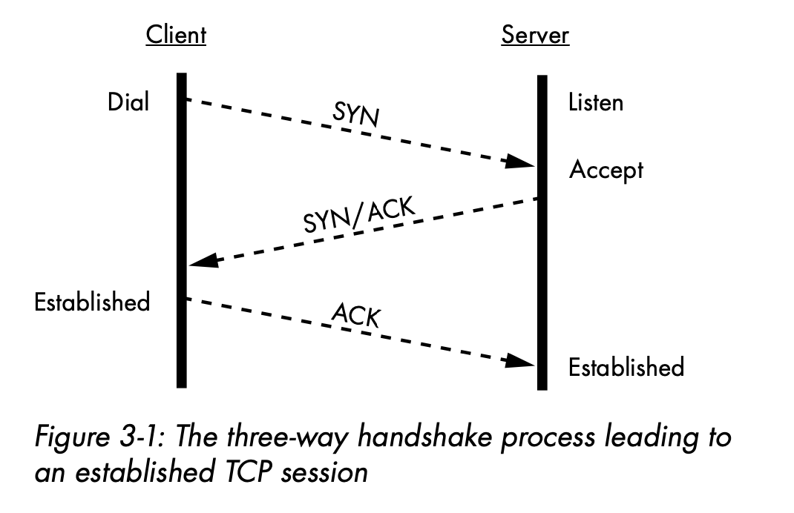
Transmission control protocol (TCP)
Working with TCP Sessions
A TCP session allows you to deliver a stream of data of any size to a recipient and receive confirmation that the recipient received the data. This saves you from the inefficiency of sending a large amount of data across a network, only to find out at the end of the transmission that the recipient didn’t receive it.
A TCP connection uses a three-way handshake to introduce the client to the server and the server to the client. The handshake creates an established TCP session over which the client and server exchange data. Figure 3-1 illustrates the three messages sent in the handshake process.

Slide 8
TCP Sessions
Three-Way Handshake
The three-way handshake is a fundamental process in the establishment of a reliable communication channel between two devices over a network using the Transmission Control Protocol (TCP). It ensures that both the sender and the receiver are ready to exchange data and sets up initial parameters for the TCP connection. The three steps involved in the three-way handshake are:
SYN (Synchronize): The process begins with the sender (Client) initiating a connection by sending a TCP packet with the SYN (synchronize) flag set to the receiver (Server)
SYN-ACK (Synchronize-Acknowledge): Upon receiving the SYN packet, the receiver responds with a TCP packet that has both the SYN and ACK (acknowledge) flags set
ACK (Acknowledge): The sender, upon receiving the SYN-ACK packet, acknowledges the receipt of the acknowledgment (ACK) by sending a TCP packet with the ACK flag set

Slide 9
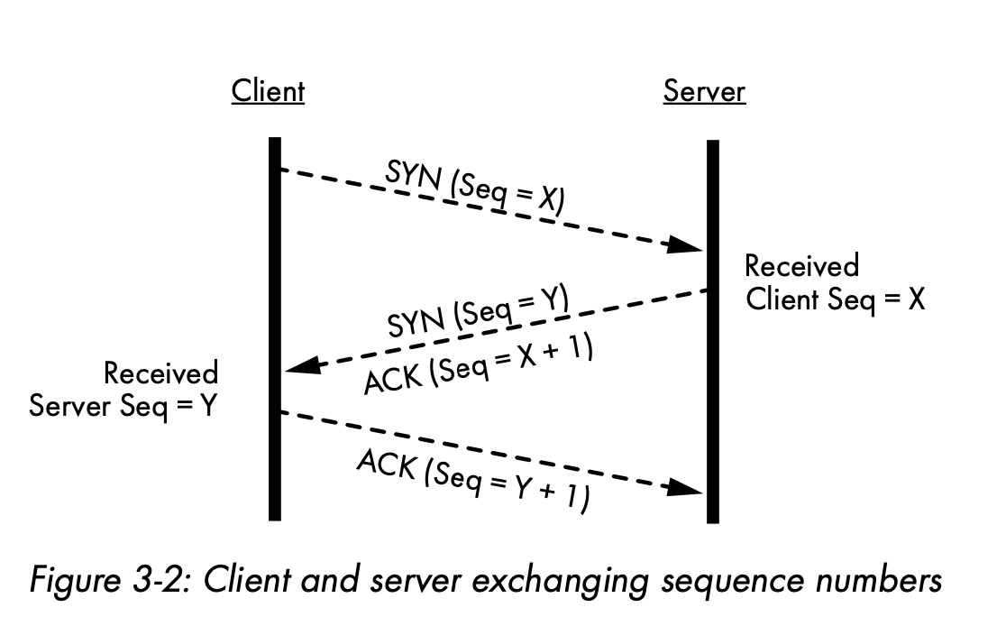
TCP Sessions
Acknowledging Receipt of Packets by Using Their Sequence Numbers
Each TCP packet contains a sequence number, which the receiver uses to acknowledge receipt of each packet and properly order the packets for pre- sentation to your Go application (Figure 3-2).
The client’s operating system determines the initial sequence number (X in Figure 3-2) and sends it to the server in the client’s SYN packet during the handshake.
The server acknowledges receipt of the packet by including this sequence number in its ACK packet to the client.
Likewise, the server shares its generated sequence number Y in its SYN packet to the client. The client replies with its ACK to the server.
One ACK packet can acknowledge the receipt of one or more packets from the sender.

Slide 10
TCP Sessions
Receive Buffers and Window Sizes
In the context of network communication, receive buffers and window sizes are related concepts associated with the Transmission Control Protocol (TCP). These parameters play a crucial role in the efficient and reliable transfer of data between two communicating devices.
Receive Buffers:
Receive buffers, also known as receive windows, are memory spaces on the receiving device (such as a computer or server) that temporarily store incoming data before it is processed.
Purpose: to smooth out the flow of data and provide a buffer zone for received packets. This helps in handling variations in the rate of incoming data and provides a place for the receiver to store data while it is being processed or before being delivered to the application layer.\
Window Sizes:
n TCP, the window size refers to the amount of data (in bytes) that a sender can transmit before receiving an acknowledgment from the receiver.
Purpose: he window size is a flow control mechanism that helps regulate the rate of data transmission and prevent network congestion. It allows the sender to adjust the amount of unacknowledged data it can have in flight at any given time, optimizing the usage of the network bandwidth.

Slide 11
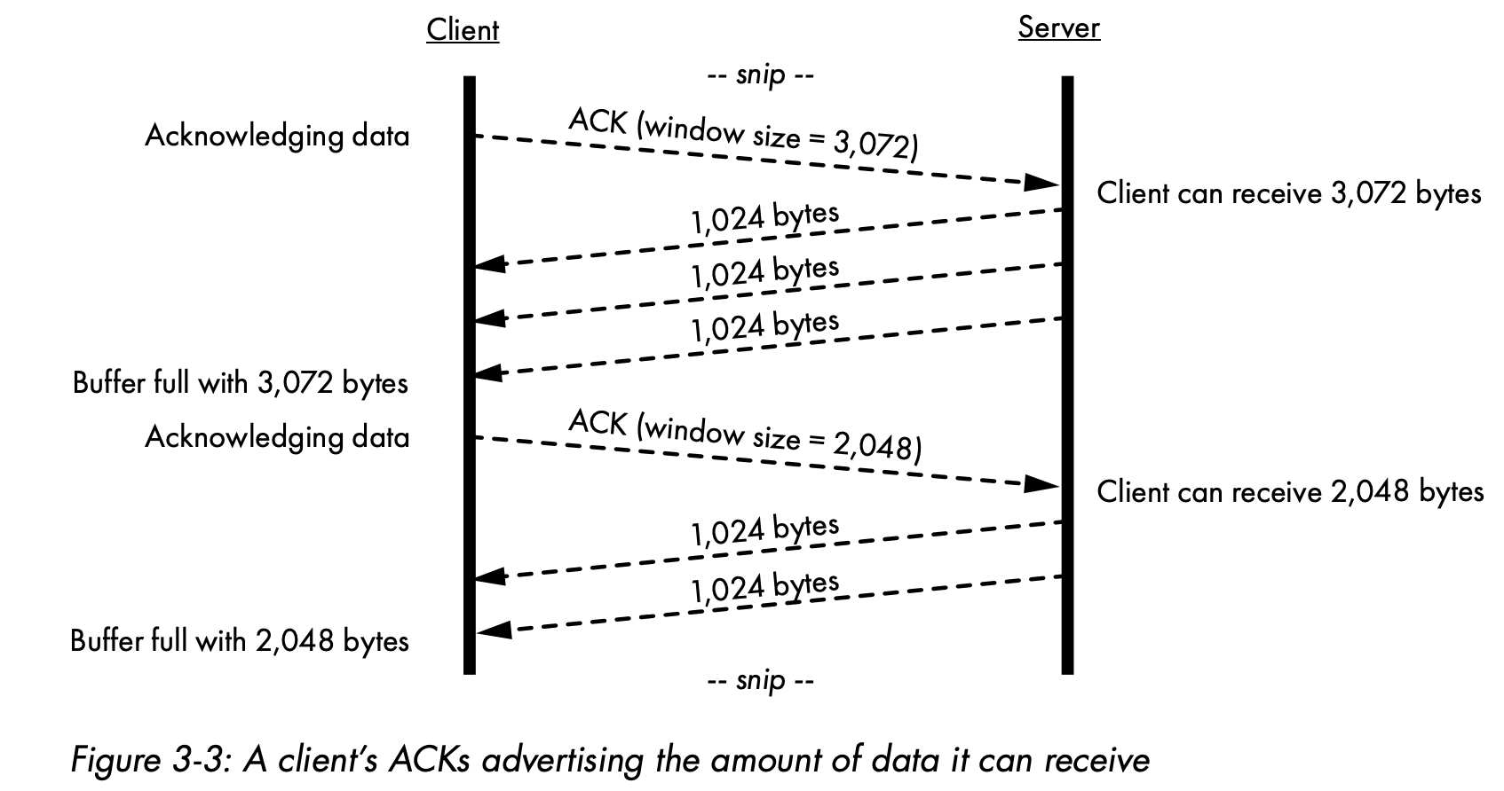
TCP Sessions
Receive Buffers and Window Sizes
Both the client and the server keep track of each other’s window size and do their best to completely fill each other’s receive buffers. This method of receiving the window size in an ACK packet, sending data, receiving an updated window size in the next ACK, and then sending more data—is known as a sliding window, as shown in Figure 3-3. Each side of the connec- tion offers up a window of data that can it can receive at any one time.

Slide 12
TCP Sessions
Gracefully Terminating TCP Sessions
Gracefully terminating a TCP (Transmission Control Protocol) session involves following a set of procedures to ensure that both the client and server can conclude their communication in an orderly manner.
The process typically includes a series of steps to signal the intent to close the connection, exchange acknowledgment messages, and allow for any remaining data to be transmitted before finalizing the termination.
The steps involved in a graceful TCP session termination are:
Application Layer Close
TCP FIN (Finish) Flags
Acknowledgment (ACK)
Data Exchange in Hald-Closed State
Second FIN and ACK
Final ACK

Slide 13
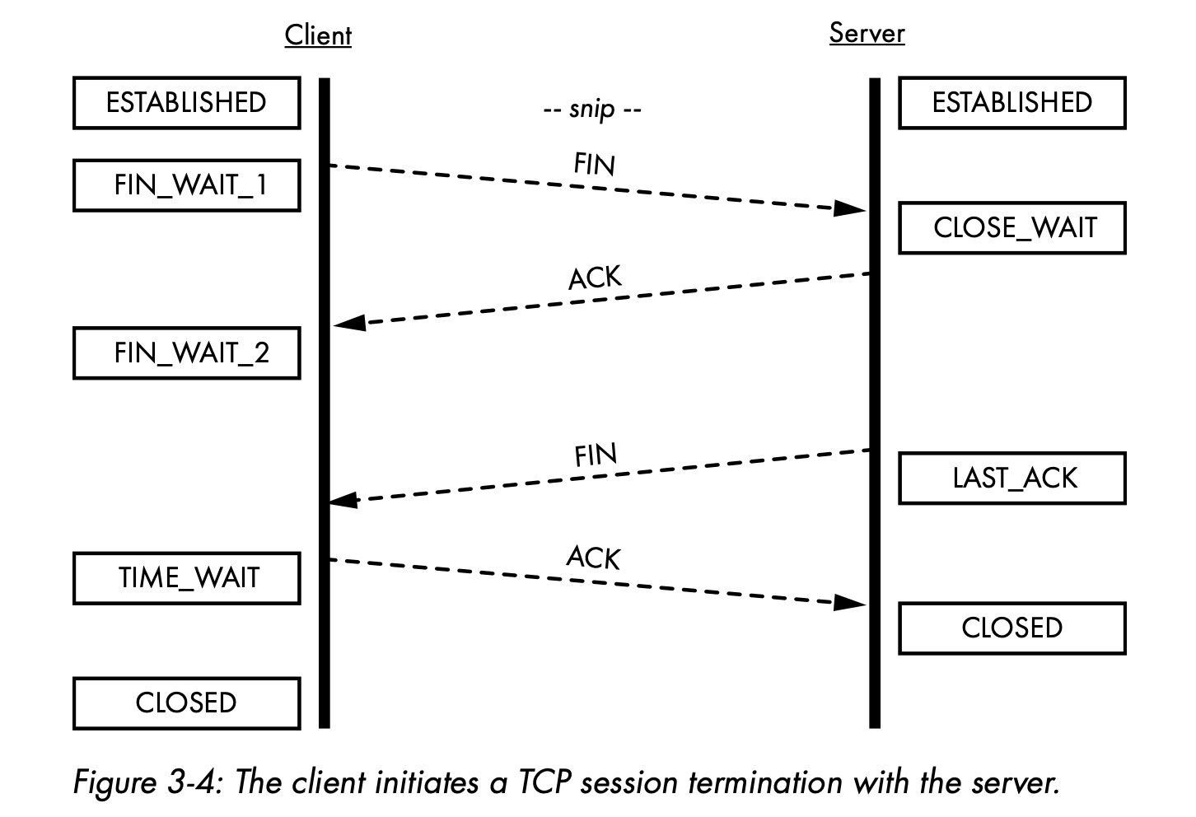
TCP Sessions
Gracefully Terminating TCP Sessions
Notes:
The client’s connection state changes from ESTABLISHED to FIN _WAIT_1, which indicates the client is in the process of tearing down the connection from its end and is waiting for the server’s acknowledgment. The server acknowledges the client’s FIN and changes its connection state from ESTABLISHED to CLOSE_WAIT. The server sends its own FIN packet, changing its state to LAST_ACK, indicating it’s waiting for a final acknowl- edgment from the client. The client acknowledges the server’s FIN and enters a TIME_WAIT state, whose purpose is to allow the client’s final ACK packet to reach the server. The client waits for twice the maximum segment life- time (the segment lifetime arbitrarily defaults to two minutes, per RFC 793, but your operating system may allow you to tweak this value), then changes its connection state to CLOSED without any further input required from the server. The maximum segment lifetime is the duration a TCP segment can remain in transit before the sender considers it abandoned. Upon receiving the client’s last ACK packet, the server immediately changes its connection state to CLOSED, fully terminating the TCP session.

Slide 14
Establish TCP with Go Library

Slide 15
Establish TCP
Establishing a TCP Connection by Using Go’s Standard Library
The net package in Go’s standard library includes good support for creating TCP-based servers and clients capable of connecting to those servers.
Even so, it’s your responsibility to make sure you handle the connection appropriately.
Your software should be attentive to incoming data and always strive to gracefully shut down the connection. Let’s write a TCP server that can listen for incoming TCP connections, initiate connections from a client, accept and asynchronously handle each connection, exchange data, and terminate the connection.

Slide 16
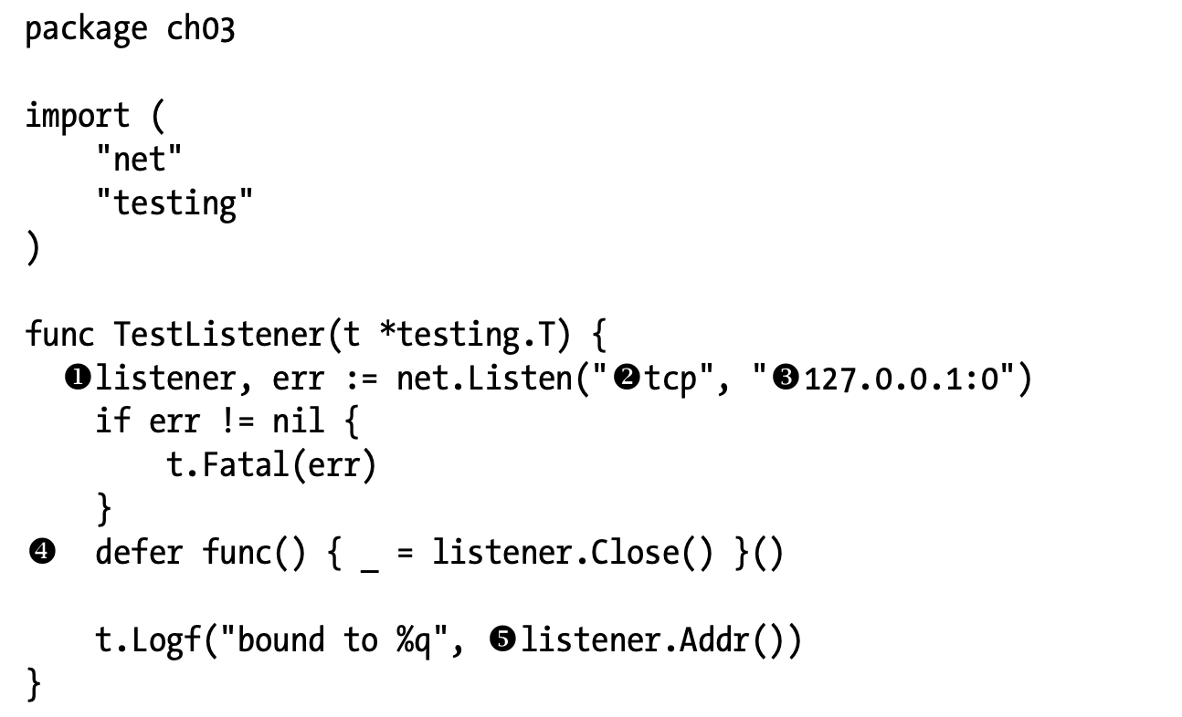
Establish TCP
Binding, Listening for, and Accepting Connections
To create a TCP server capable of listening for incoming connections (called a listener), use the net.Listen function. This function will return an object that implements the net.Listener interface. Listing 3-1 shows the creation of a listener.
Binding means that the operating system has exclusively assigned the port on the given IP address to the listener.

Slide 17
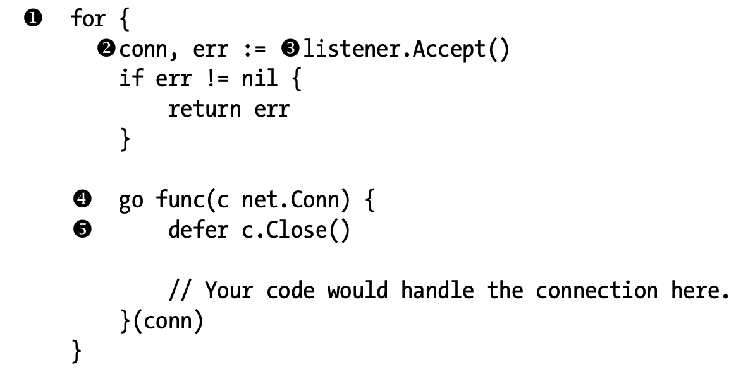
Establish TCP
Binding, Listening for, and Accepting Connections
You should always be diligent about closing your listener gracefully by calling its Close method 4, often in a defer if it makes sense for your code. Granted, this is a test case, and Go will tear down the listener when the test completes, but it’s good practice nonetheless. Failure to close the listener may lead to memory leaks or deadlocks in your code, because calls to the listener’s Accept method may block indefinitely. Closing the listener immedi- ately unblocks calls to the Accept method.
Listing 3-2 demonstrates how a listener can accept incoming TCP connections.

Slide 18
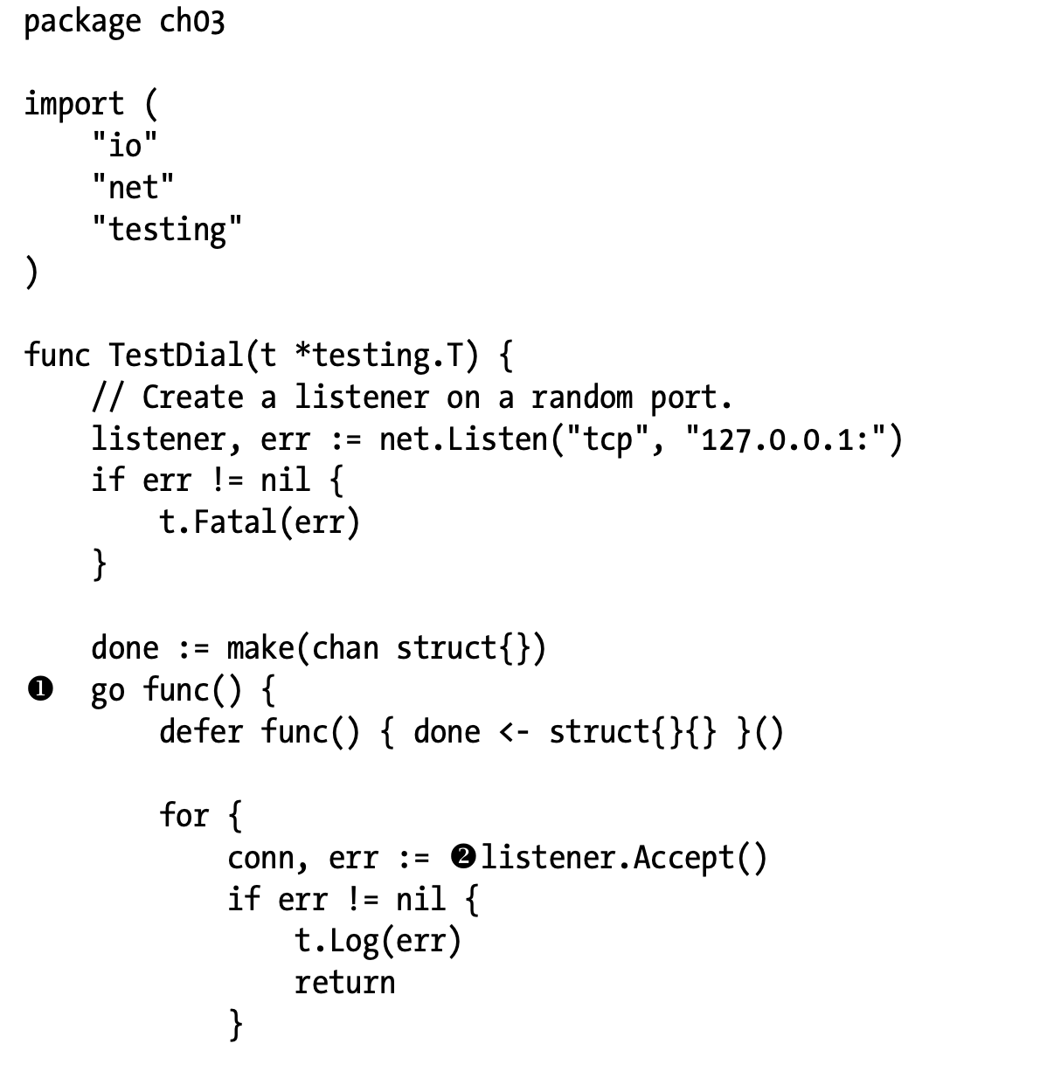
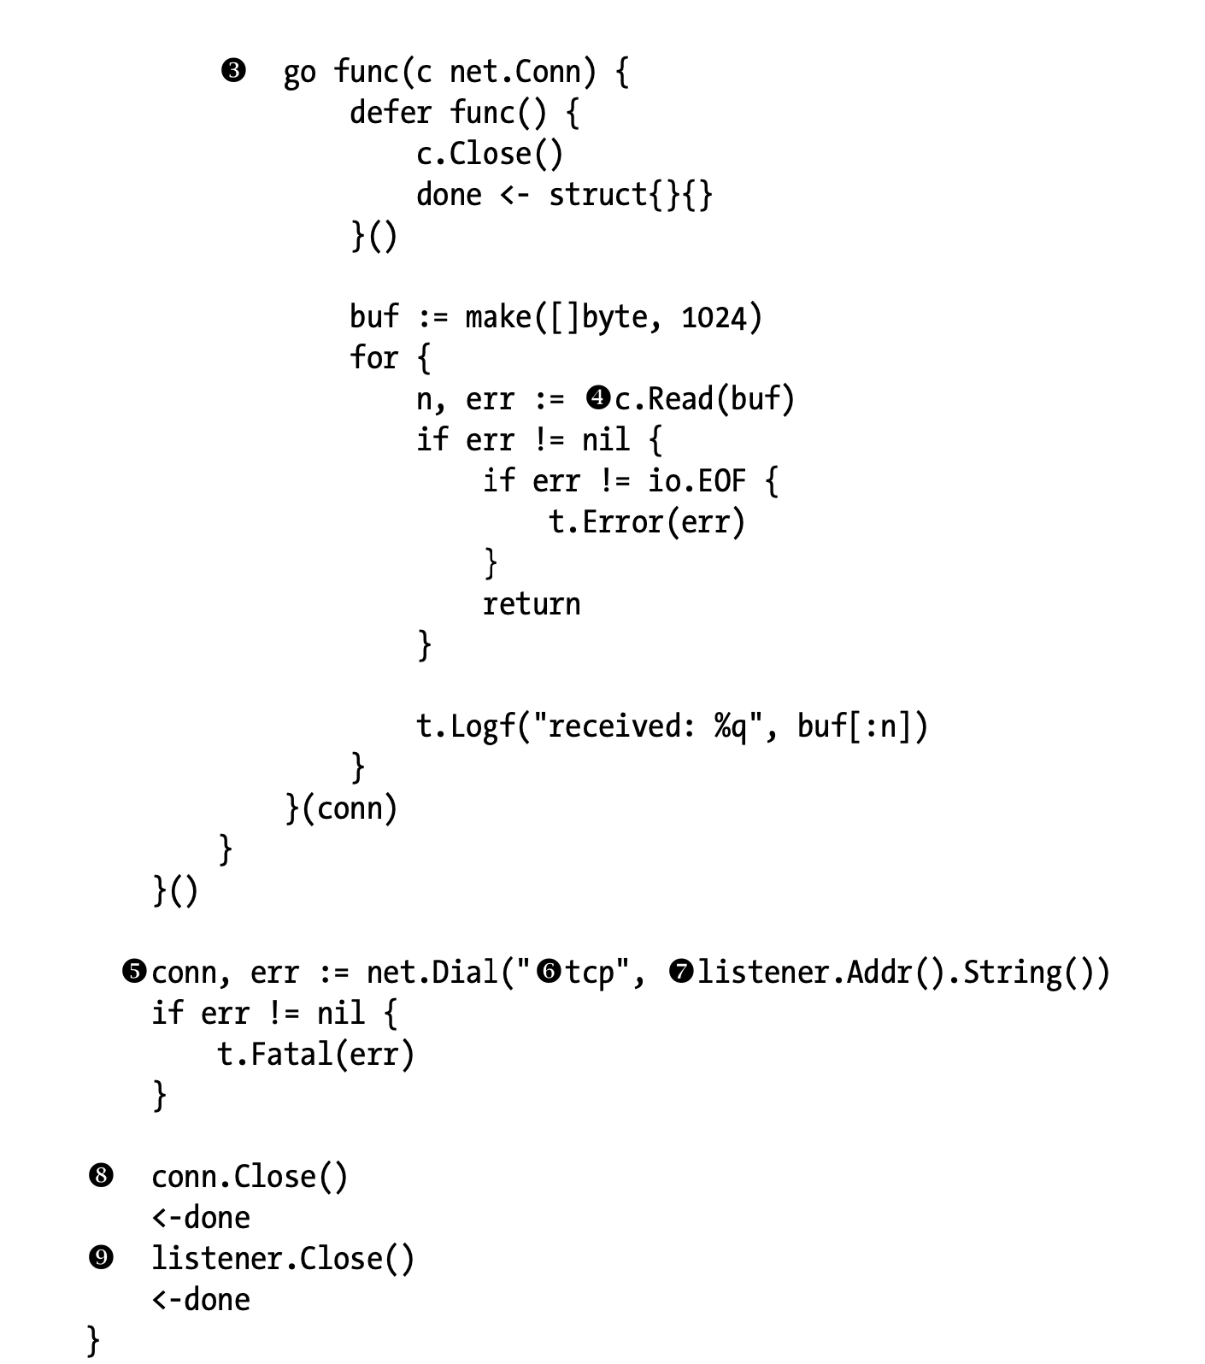
Establish TCP
Establishing a Connection with a Server
From the client’s side, Go’s standard library net package makes reaching out and establishing a connection with a server a simple matter. Listing 3-3 isa test that demonstrates the process of initiating a TCP connection with a server listening to 127.0.0.1 on a random port.
You start by creating a listener on the IP address 127.0.0.1, which the client will connect to. You omit the port number altogether, so Go will ran- domly pick an available port for you.

Slide 19
references
Adam Woodbeck - Network Programming with Go_ Learn to Code Secure and Reliable Network Services from Scratch-No Starch Press (2021).
https://www.fortinet.com/resources/cyberglossary/tcp-ip#:~:text=What%20is%20TCP%3F,exchange%20messages%20over%20a%20network.
https://www.juniper.net/documentation/us/en/software/junos/flow-packet-processing/topics/topic-map/security-tcp-session-checks.html

Slide 20
Thankyou

